Slide 1

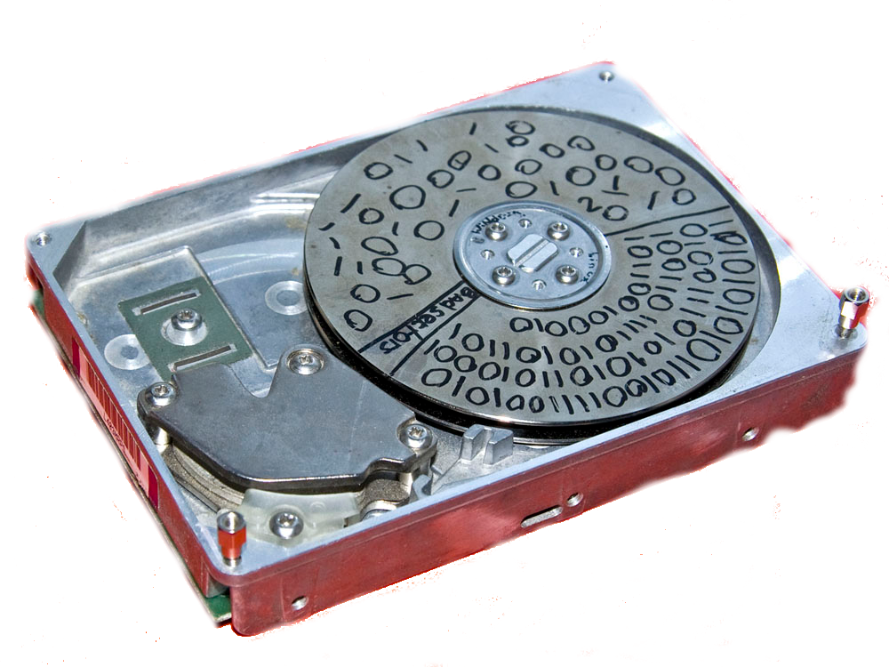




4 – Linux File Systems
Marian Marinov
CEO of 1H Ltd.
mm@1h.com
Borislav Varadinov
System Administrator
bobi [ at ] itp.bg

Slide 2
Agenda
File System Architecture
Virtual File System Layer
Directory Structure
Mount operations

Slide 3
Agenda
File system types
Local
Log-structured - NAND
Pseudo
Network
Cluster
Distributed

Slide 4

File System Architecture
There is NO DIRECTORY!

Slide 5
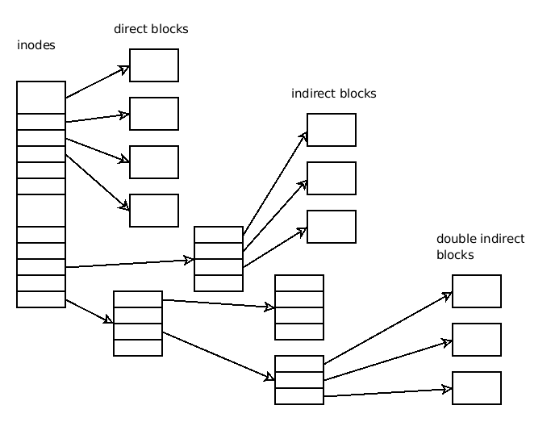
File System Architecture
inode
dentry

Slide 6
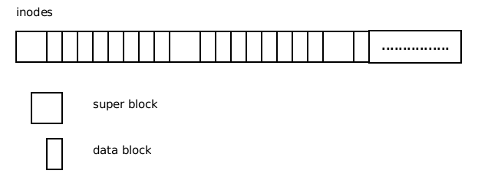
File System Architecture
Super Blocks

Slide 7
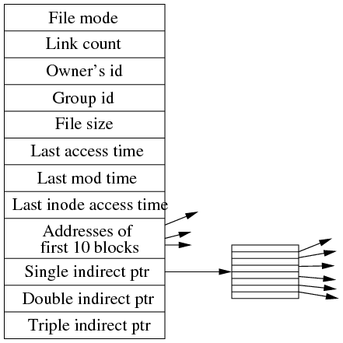

File System Architecture

Slide 8

File System Architecture
Soft/symlinks
Hardlinks

Slide 9
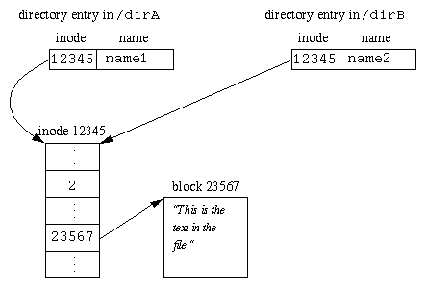
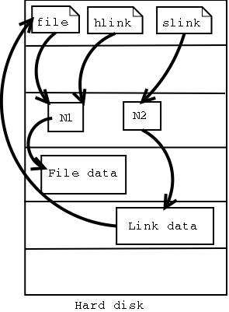
File System Architecture

Slide 10
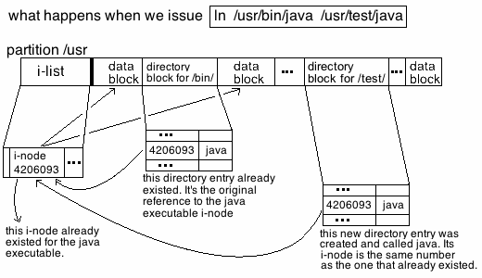
File System Architecture
ln source destination
ln -s source destination

Slide 11

File System Architecture
DATA is never erased... it gets OVERWRITTEN!

Slide 12
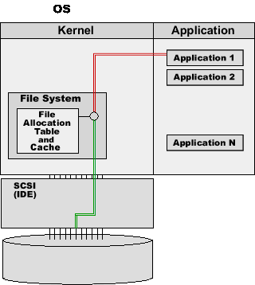
Local File System

Slide 13
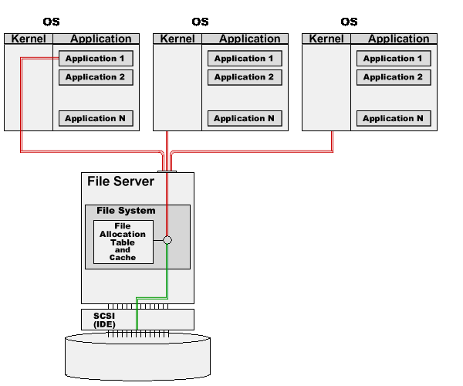
Network File System

Slide 14
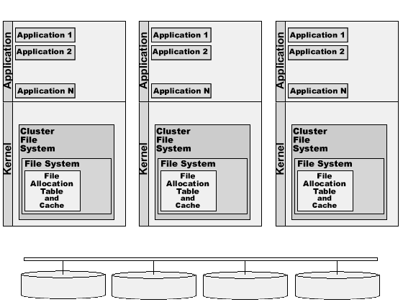
Cluster File System

Slide 15

Cluster File System
“One DLM to rule them all, one DLM to mind them, one DLM to sync them all, and in the cluster, bind them”

Slide 16
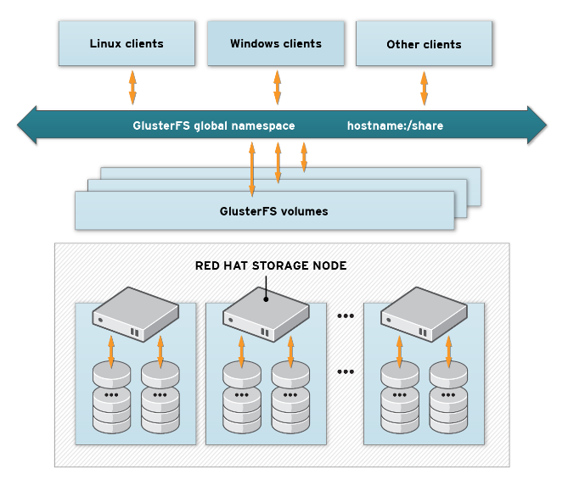
Distributed File System

Slide 17
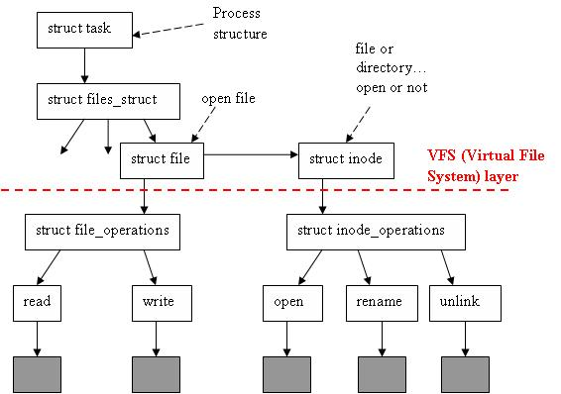
Virtual File System Layer

Slide 18
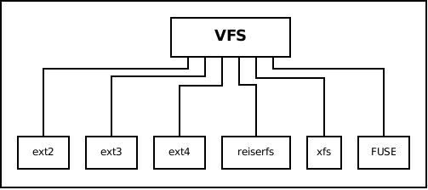
Virtual File System Layer
Introduced April 1992

Slide 19
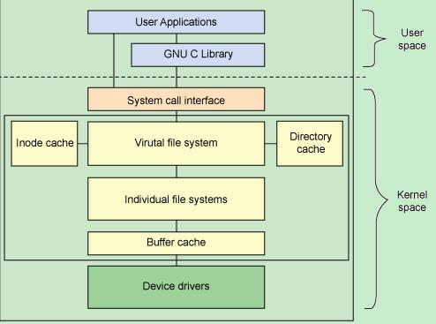
VFS Caches

Slide 20
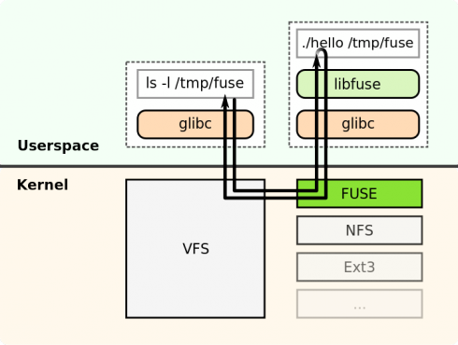
FUSE

Slide 21
Mounting
Attaching a device into the directory tree
Mount point – a destination directory where a device is mounted
Creates an entry in the kernel for each mounted device/dir
/proc/mounts
/etc/fstab, /etc/mtab

Slide 22
Mounting - CMD
cat /proc/partitions
cat /proc/mounts
mount
umount
/etc/fstab
/dev/sdb2 / ext4 defaults,noatime,nodiratime 0 0
/dev/sdb1 /boot ext2 defaults,noatime,nodiratime 0 0
proc /proc proc defaults 0 0
tmpfs /dev/shm tmpfs defaults 0 0
/home/hackman /fedora/home/hackman none rw,bind,auto 0 0
//10.2.0.11/share /storage/beast cifs user=hackman,password=p1r@tk3,uid=1000,gid=1000,noauto 0 0

Slide 23
Ext/2/3/4
First Linux FS – MinixFS
And there we go....
  Ext - April 1992, Linux 0.96c
  Ext2 – January 1993
  Ext3 – November 2001
  Ext4 – October 2006

Slide 24
MinixFS
Max. partition size – 64MB
Max. file name size – 14 chars
Ownership – uid, gid
Permissions – user, group, others

Slide 25
Ext
Max. partition size – 2GB
Max. file name size – 255 chars
No support for time stamps
  Access
  Inode modification
  Data modification

Slide 26
Ext2
Max. partition size – 32TB
Max. file name size – 255 chars
Max. file size – 2TB
Max. Number of files - 10¹⁸
FS Perms
Time stamps

Slide 27
Ext3
Max. partition size – 32TB
Max. file name size – 255 chars
Max. file size – 2TB
Max. Number of files - 10¹⁸
Sub directory limit - 32,000
Time stamps
Has Jurnal

Slide 28
Ext4
Max. partition size – 1EB
Max. file name size – 255 chars
Max. file size – 2TB
Max. Number of files - 10¹⁸
Sub directory limit - 64,000
File space pre-allocation
File space delayed allocation

Slide 29
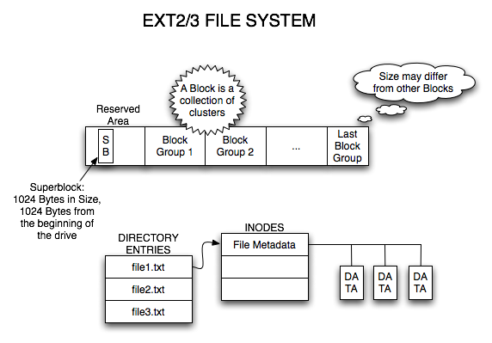
Ext/2/3

Slide 30
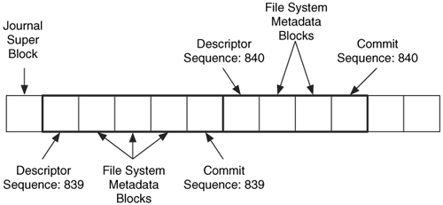
Ext3

Slide 31
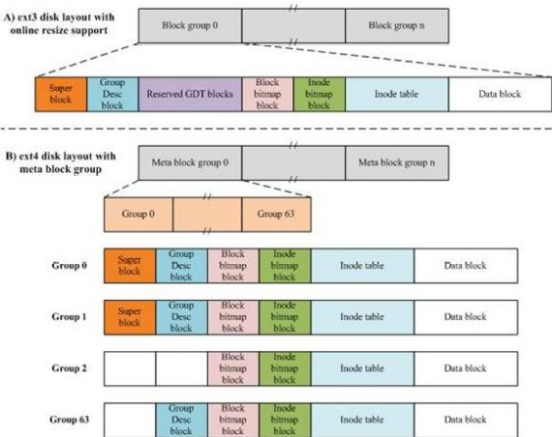
Ext4

Slide 32
ReiserFS
Introduced 2001
Metadata-only journaling
Online resizing (growth only)
Tail packing, a scheme to reduce internal fragmentation.
Max. file size - 1EB
Max. number of files - 2³²

Slide 33
ReiserFS

Slide 34
XFS

Slide 35
XFS

Slide 36
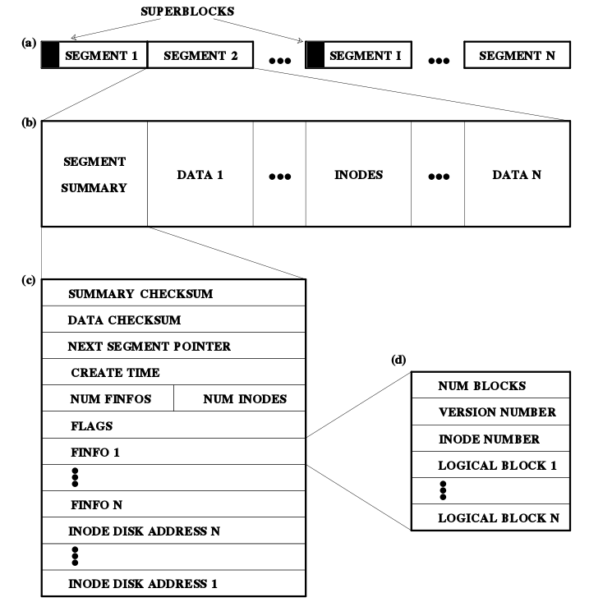
Log-
structured
File
Systems
Architect-
ure

Slide 37
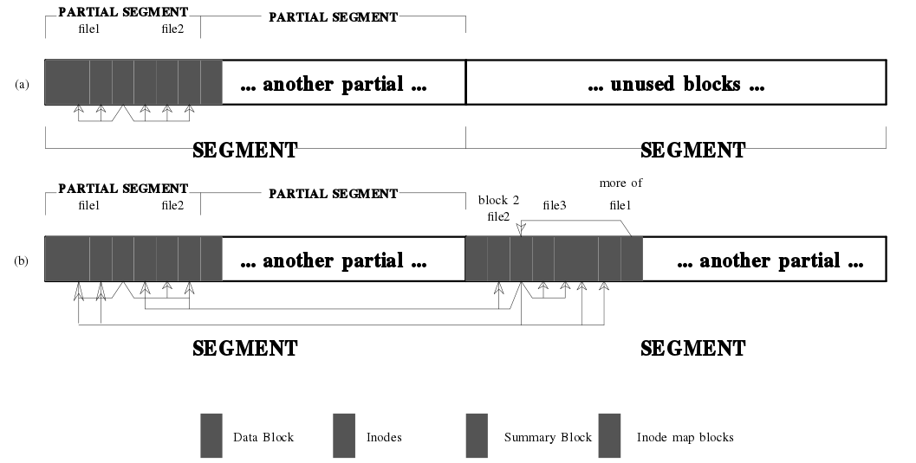
Log-structured
File Systems Architecture

Slide 38
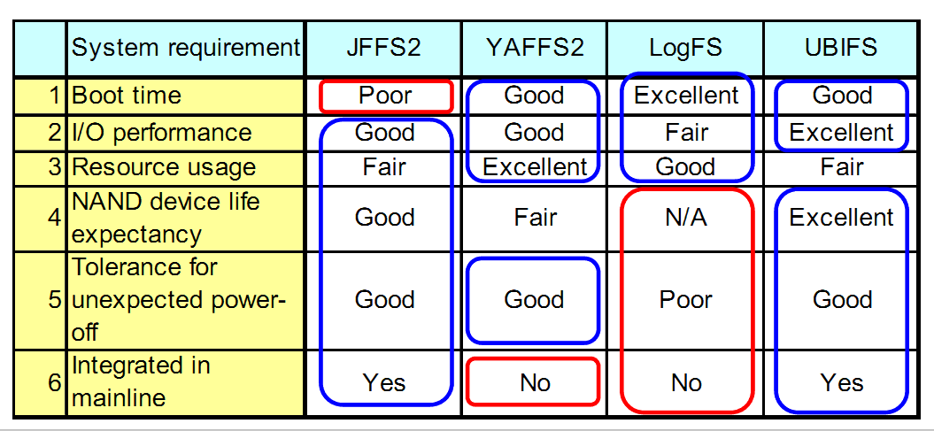
Log-structured
NAND File Systems
NILFS2
F2FS

Slide 39
Pseudo File Systems
procfs
sysfs
debugfs
configfs
tmpfs
others

Slide 40
Pseudo File Systems
debugfs is designed to provide Kernel Devs with simple way to push data into User space
configfs is for creating, managing and destroying kernel objects from user-space
sysfs is for viewing and manipulating objects from user-space which are created and destroyed by kernel space

Slide 41
Pseudo File Systems
procfs is the first FS to provide easy access to kernel-space from user-space
tmpfs is a very fast in-memory file system

Slide 42
Network File Systems
Network File System – NFS v3/v4
Common Internet File System - CIFS

Slide 43
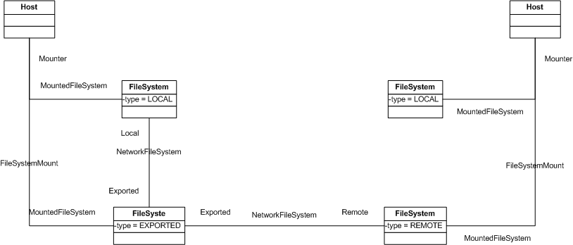
Network File Systems

Slide 44
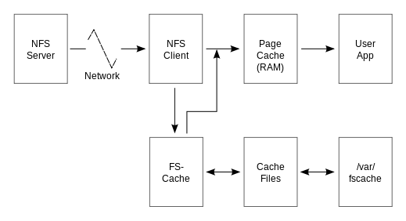
Network File Systems

Slide 45
Cluster File Systems
GFS, GFS2
OCFS2

Slide 46
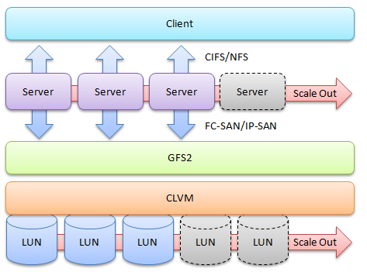
Cluster File Systems - GFS2

Slide 47
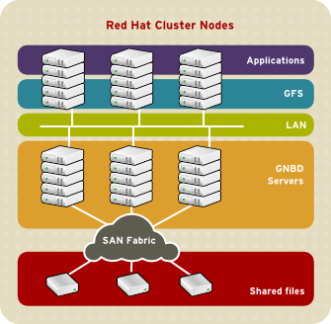
Cluster File Systems - GFS2

Slide 48
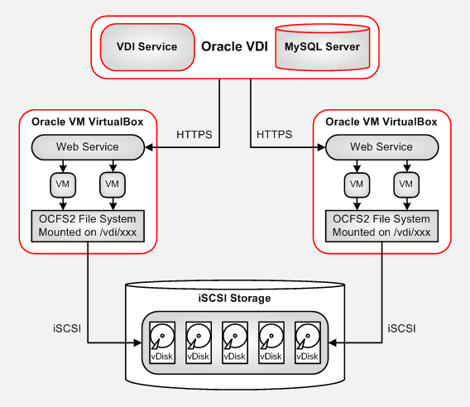
Cluster File Systems - OCFS2

Slide 49
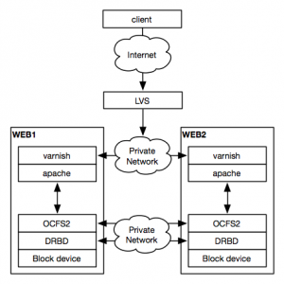
Cluster File Systems - OCFS2

Slide 50
Distributed File Systems
Hadoop
Lustre
GlusterFS
Gfarm
FhgFS
PohmelFS
Ceph
PVFS2

Slide 51
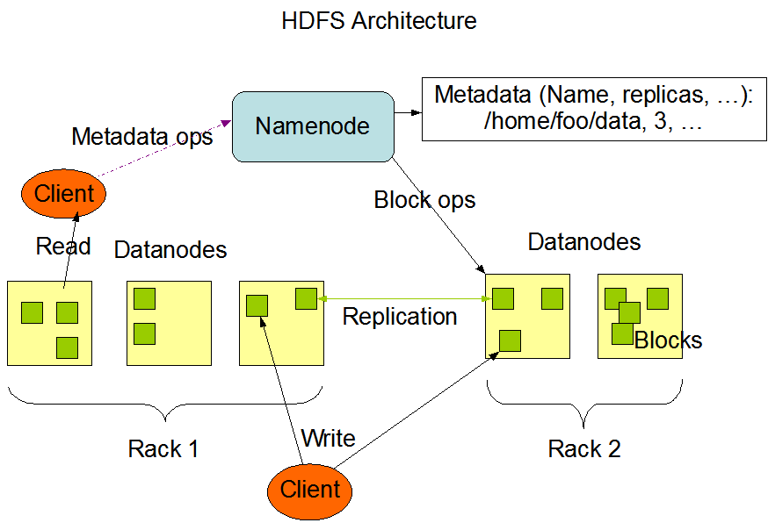
Hadoop

Slide 52
Hadoop
Large block FS – 64MB
Write mostly FS
Writes smaller then one block wait
Adding/removing nodes requires restart of the cluster

Slide 53
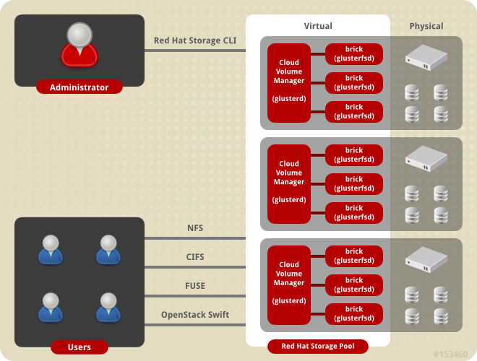
GlusterFS

Slide 54
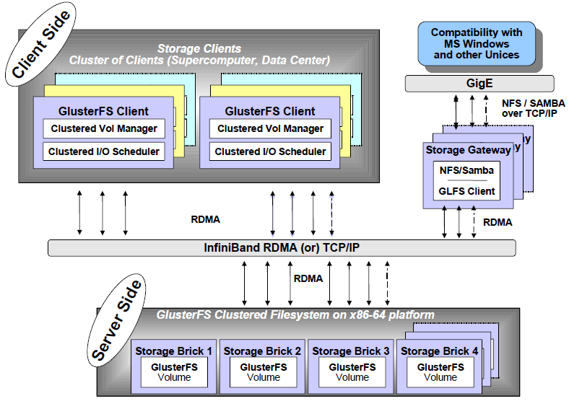
GlusterFS

Slide 55
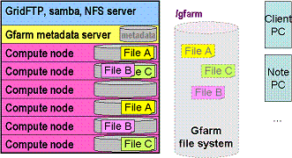
GFarm

Slide 56
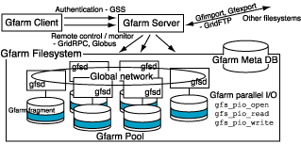
GFarm

Slide 57
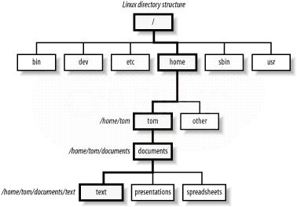
Linux Directory Structure

Slide 58
Linux Directory Structure

Slide 59
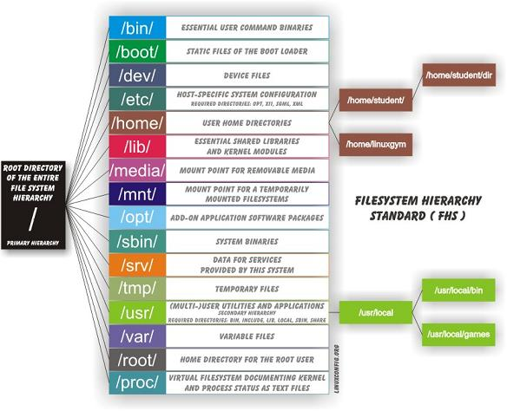

Slide 60
Links
Wikipedia - Comparison of file systems
Ext2 and OCFS2 on-disk layout
Ext2 on-disk layout
XFS on-disk structure
ReiserFS on-disk structure
RFSTool for Windows
XFS Scalability
BtrFS on-disk structure
NILFS2 the new kid on the block
Usenix paper on Log-Structured File Systems
http://academy.telerik.com/student-courses/software-technologies/os-windows-linux/

Slide 61

Linux File Systems
http://academy.telerik.com/student-courses/software-technologies/os-windows-linux/

Slide 62


Slide 63



Free Trainings @ Telerik Academy
Operating Systems @ Telerik Academy
http://telerikacademy.com/Courses/Courses/Details/35
  Telerik Software Academy
    academy.telerik.com
  Telerik Academy @ Facebook
    facebook.com/TelerikAcademy
  Telerik Software Academy Forums
    forums.academy.telerik.com

